Slide 1
Securing Angular 5 Website using JWT and WebAPI
Kris kilton
kkilton@revgen.com

Slide 2
Kris Kilton
.NET developer since 2001
Contractor/Consultant for 11+ years
Not a security expert!
3rd foray into token security
No coding on the side
Snowboarder, SUPer, and Mountain Biker

Slide 3
Goals
Understand why to use JWT (in the way I’ll show you)
Understand basics of JWT
Understand how to generate JWT using WebAPI
Understand how to use the JWT in the UI to secure the website
Understand how to validate the JWT in the WebAPI

Slide 4
JSON Web Tokens
Open standard RFC 7519 May 2015
JSON Web Token (JWT) is a compact claims representation format intended for space constrained environments such as HTTP Authorization headers and URI query parameters.
Server signed only
(JWS) JSON Web Signature
If you need encryption - JSON Web Encryption (JWE)
Small and easily parsed into objects
Header - base64url-encoded
Payload - base64url-encoded
Signature – encrypted (signed) hash of header and payload
SSO potential

Slide 5
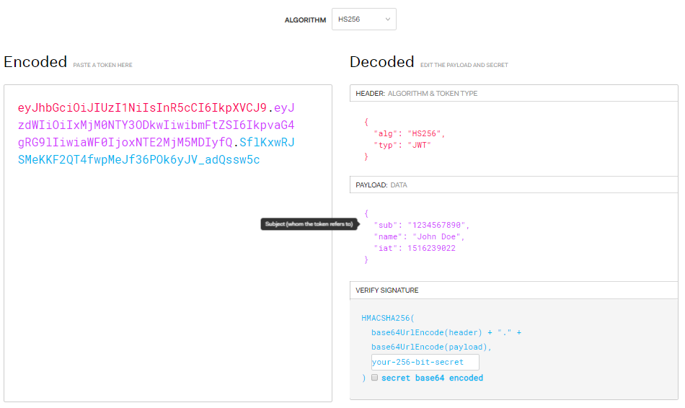
JSON Web Tokens cont.
https://jwt.io/

Slide 6
ASP.NET Web API 2
RESTful architecture
Support for JWT - JwtSecurityTokenHandler Class
Install-Packages
System.IdentityModel.Tokens.Jwt
Microsoft.IdentityModel.Tokens
Microsoft.AspNet.WebApi.Cors
Use filters for lifecycle injection
AuthorizationFilter
ActionFilter
OnActionExecuted - Renew token
Authorize Attribute

Slide 7
Angular 5
Decode Token’s payload using base 64 Unicode
HttpInterceptor since 4.3
Request
Response
Router Guards

Slide 8
Workflow
UI – Login
API – authenticate user
Respond with token
UI – Store token
UI – request resource
Send token in header
API – validate token
Do request
Renew token and send it back in the header
UI – store new token

Slide 9
Demo This example details setting up a secure website without a dedicated token server

Slide 10
Other security to consider
Logical security in UI and API
/customer/1234/order/4567

Slide 11
Links
Definition
https://tools.ietf.org/html/draft-ietf-oauth-json-web-token-07
Decoding
https://github.com/auth0/jwt-decode
Library support
https://jwt.io/
WebAPI CORS
https://docs.microsoft.com/en-us/aspnet/web-api/overview/security/enabling-cross-origin-requests-in-web-api
Source Code
https://github.com/kkilton/jwt-demo
https://github.com/kkilton/jwt-demo-api
https://github.com/kkilton/jwt-demo-training

Slide 12
Thank you

